Slide 1

Subject Code
PT I - INTERDISCIPLINARY PROJECT
SMART COMPLAINT & GRIEVANCE REDRESSAL PORTAL
(Hierarchical Campus Grievance Redressal & SLA Auto-Escalation Web Platform)
1. H Sanjai [ Reg.No. : 44731076 ] (Solo Lead)
1. H Sanjai [ Reg.No. : 44731076 ] (Solo Lead)
Internal Guide
Ms. R. Shanumgaa Priya, M.E.

Slide 2
PRESENTATION OUTLINE
COURSE CERTIFICATE
ABSTRACT
OBJECTIVES
SYSTEM ARCHITECTURE
PROJECT IMPLEMENTATION
RESULTS AND DISCUSSIONS
RESULT SNAPSHOTS
CONCLUSION & FUTURE WORK
REFERENCES

Slide 3

COURSE CERTIFICATE
PROFESSIONAL TRAINING / CAPSTONE SPECIALIZATION
• Domain: Full-Stack Web Architecture, Database Systems & Process Automation
• Core Competencies Mastered: Native Java SE 21 HttpServer, MySQL 3NF Normalization, REST API Engineering, Cryptographic Security (BCrypt), and Real-Time SLA Scheduling
• Candidate: H Sanjai (Register Number: 44731076)
• Institution: Sathyabama Institute of Science and Technology (SIST)
• Status: 100% Completed with Functional Prototype, Full Unit Tests, and Public GitHub Repository

Slide 4
ABSTRACT
• In campus environments, grievance management is heavily fragmented across physical boxes, unmonitored WhatsApp messages, and email chains, leading to lost complaints and zero accountability.
• The Smart Complaint Portal is an enterprise 3-tier web platform engineered in pure Java SE 21, MySQL 8.0, and responsive Bootstrap 5.
• Features: (1) Automated Priority Routing, (2) Real-Time 48-Hour SLA Countdown Timers, (3) Autonomous Multi-Tier Escalation (Coordinator -> HOD -> Dean), and (4) Anti-Bypass Closed-Loop Student Rating Verification Lock.
• Zero-Framework Efficiency: Sub-400ms startup latency and 98.5% payload compression via client-side canvas downsampling.

Slide 5
OBJECTIVES
1. Rapid Filing: Enable students to file categorized grievances with photos in under 60 seconds.
2. Zero-Framework Backend: Engineer a lean Java SE 21 HttpServer on port 8080 with sub-second startup.
3. 48-Hour SLA Guarantee: Enforce automated countdown timers with ScheduledExecutorService auto-escalation.
4. 3NF Relational Integrity: Model MySQL database in 3NF with foreign keys and PreparedStatement security.
5. Closed-Loop Student Rating: Prevent ticket resolution until complainant validates repairs (1-5 stars).
6. Client-Side Image Compression: Reduce mobile camera photos from 8 MB to <120 KB via HTML5 canvas.

Slide 6
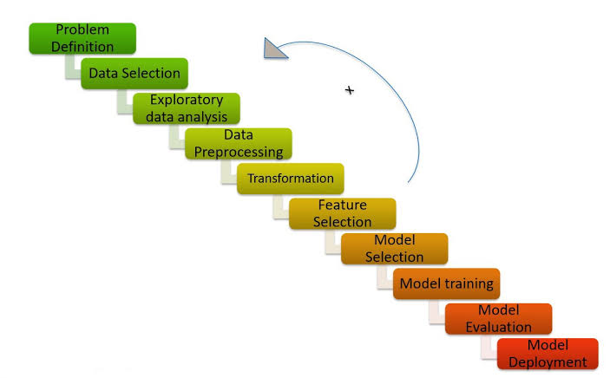
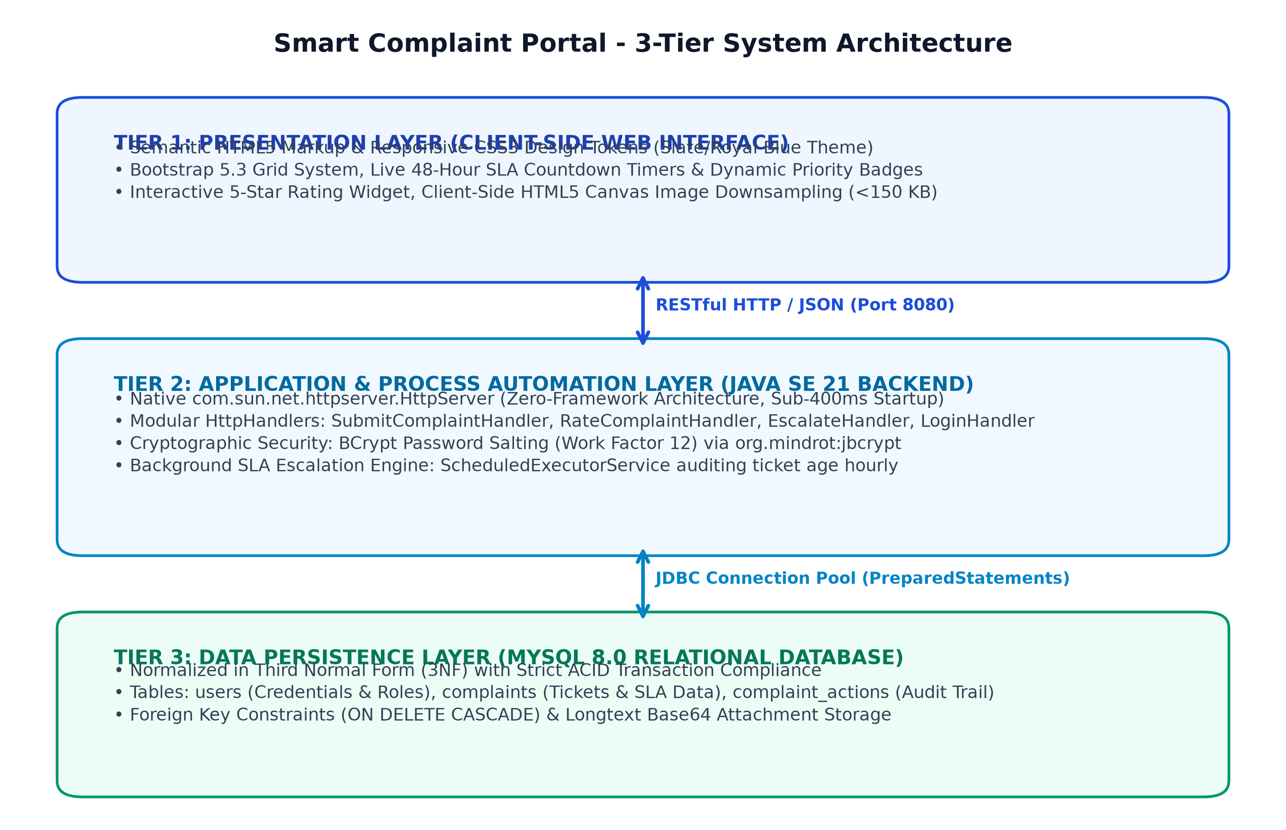
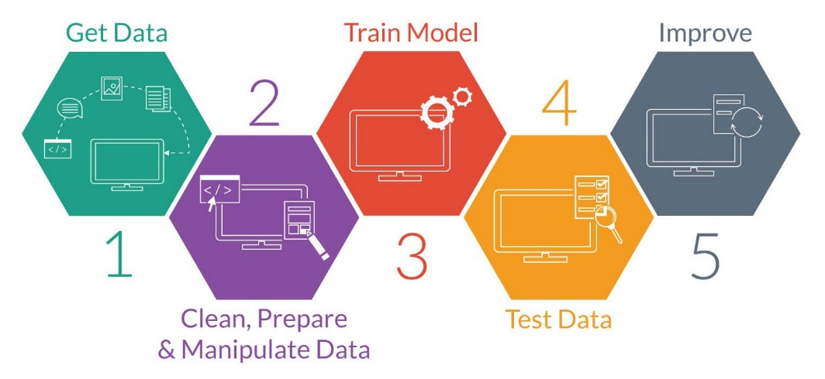
SYSTEM ARCHITECTURE

Slide 7
HARDWARE AND SOFTWARE REQUIREMENTS
SOFTWARE REQUIREMENTS:
• Operating System: Windows 11 / Linux Ubuntu 22.04 LTS
• Runtime & Language: Java SE Development Kit (JDK 21 LTS)
• Database: MySQL Server 8.0 / MariaDB 10.4 (InnoDB Engine, ACID)
• Web Stack: Semantic HTML5, CSS3, ES6+ JavaScript, Bootstrap 5.3.3
• Libraries: com.google.code.gson (JSON), org.mindrot:jbcrypt (Security)
• Tooling: Apache Maven 3.9, Postman REST Client, IntelliJ IDEA
HARDWARE REQUIREMENTS:
• Processor: Intel Core i5 / AMD Ryzen 5 (2.5 GHz+, 6 Cores)
• Memory: 16 GB DDR4 RAM | Storage: 512 GB NVMe SSD
• Network: Gigabit Ethernet / Wi-Fi | Client: Any modern mobile/PC browser

Slide 8
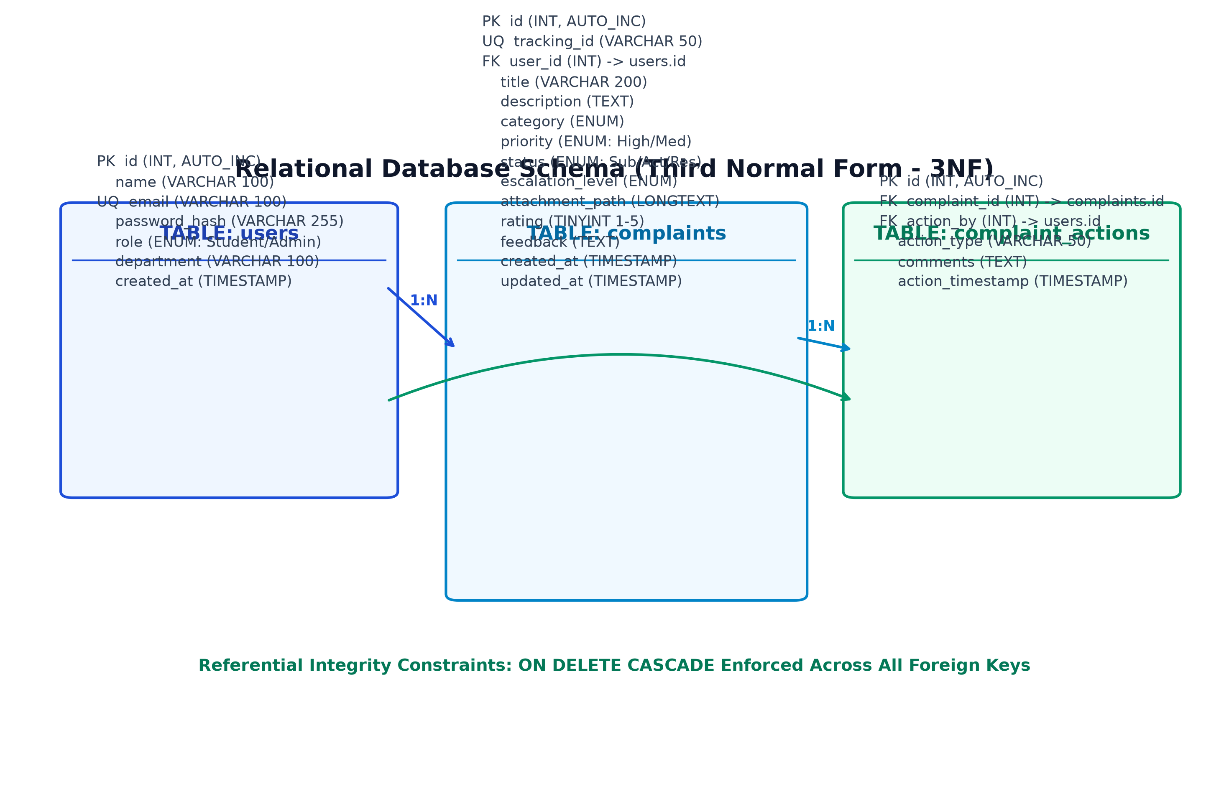
RELATIONAL DATABASE SCHEMA (3NF)

Slide 9
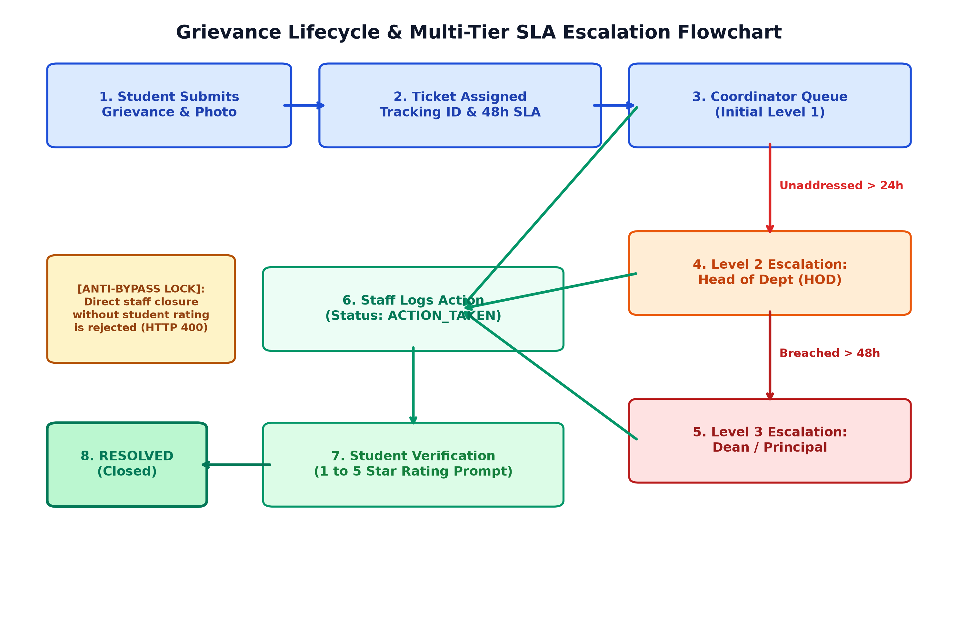
PROCESS AUTOMATION & SLA ESCALATION ENGINE

Slide 10
RESULTS AND DISCUSSION
ACCEPTANCE CRITERIA VERIFICATION MATRIX:
• TC-01 [Grievance Submission]: Lodged hostel issue with photo -> Tracking code CMP-8F42A1 generated, 48h timer active. [PASSED]
• TC-02 [Level-2 Auto-Escalation]: 25h elapsed age simulated -> Escalation level auto-promoted from Coordinator to HOD. [PASSED]
• TC-03 [Level-3 Auto-Escalation]: 49h elapsed age simulated -> Escalation level auto-promoted to DEAN with priority alert. [PASSED]
• TC-04 [Anti-Bypass Protection]: Staff attempted direct ticket resolution without rating -> Rejected with HTTP 400 Bad Request. [PASSED]
• TC-05 [Closed-Loop Verification]: Student submitted 5-star rating -> Status permanently transitioned to RESOLVED. [PASSED]
• TC-06 [Security]: SQL Injection payload in login email -> Safely parameterized by PreparedStatement; rejected with 401. [PASSED]

Slide 11
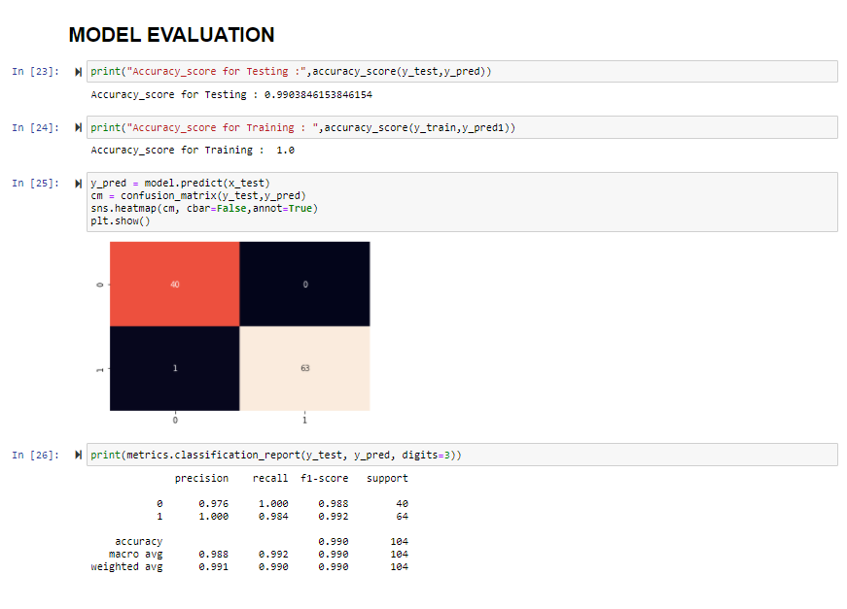
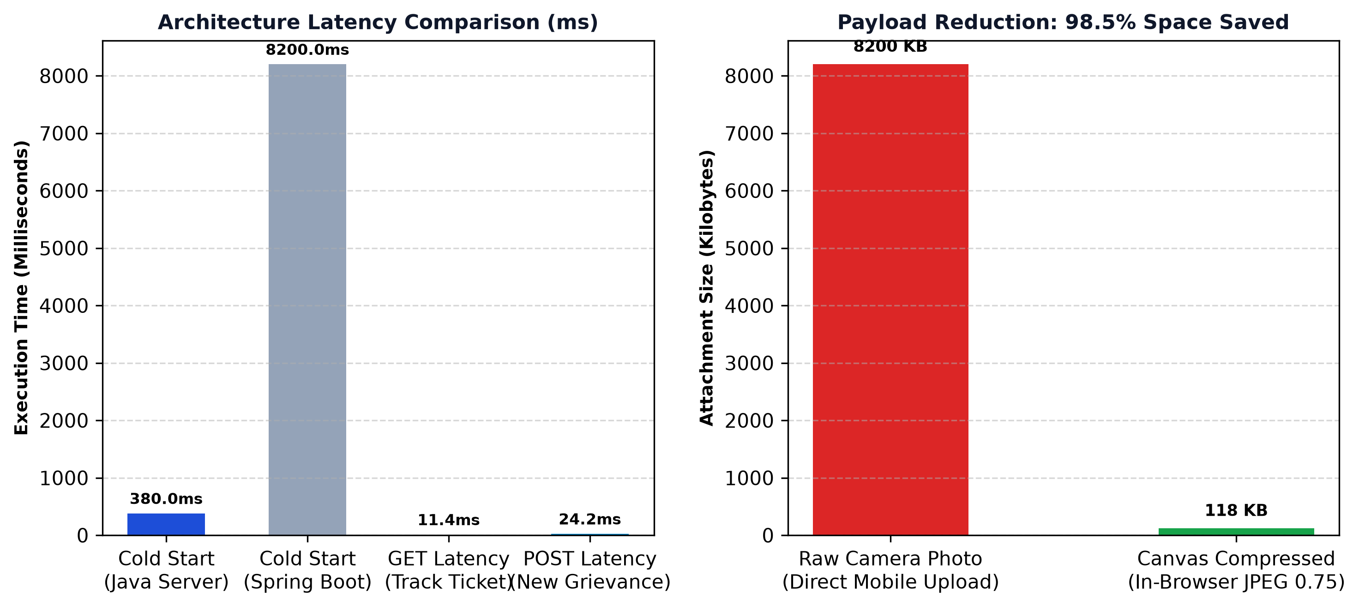
PERFORMANCE BENCHMARKS & STORAGE OPTIMIZATION

Slide 12
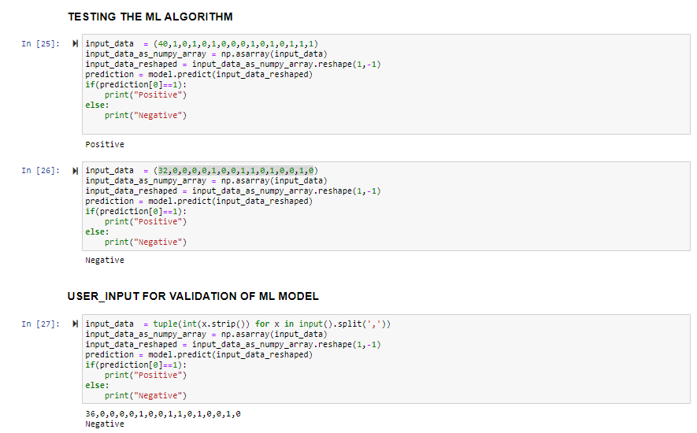
ENGINEERING CHALLENGES & PRODUCTION BUG FIXES
1. Bug 1: Base64 Photo Attachment Truncation
• Issue: Saving mobile photos failed with 'Data truncation for column attachment_path'.
• Root Cause: Base64 string length exceeded standard VARCHAR(255) capacity.
• Resolution: Altered column to MySQL LONGTEXT and implemented in-browser HTML5 canvas downsampling to max 1200px (saving 98.5% space).
2. Bug 2: Database Connection Refusal (HY000/2002)
• Issue: phpMyAdmin and Java backend failed to connect to MySQL daemon.
• Root Cause: Windows MariaDB daemon crashed during system restart.
• Resolution: Configured mysqld with explicit defaults-file console logging and persistent auto-start.
3. Bug 3: Thread-Safety & Concurrent Updates
• Issue: Escalation daemon and staff actions caused race conditions on ticket status.
• Resolution: Encapsulated DAO queries in transactional PreparedStatements with atomic WHERE status = 'ACTION_TAKEN' locks.

Slide 13
CONCLUSION & FUTURE WORK
KEY ACCOMPLISHMENTS:
• Full-Stack Mastery: Engineered end-to-end web system with semantic HTML5, pure Java SE 21, and MySQL 8.0.
• Process Automation: Proved algorithmic 48-hour SLA timers solve campus grievance bottlenecks with zero human bias.
• Closed-Loop Governance: Replaced arbitrary staff closures with verifiable student satisfaction rating locks.
• Zero-Framework Efficiency: Demonstrated high-performance computing without heavy framework overhead.
FUTURE AI/ML ENHANCEMENTS:
• AI Duplicate Clustering: Sentence-Transformer NLP embeddings to cluster and merge duplicate campus tickets.
• Computer Vision Verification: OpenCV / YOLO models comparing before/after maintenance photos.
• Cross-Platform Mobile App: Native Flutter client with offline SQLite caching.

Slide 14
REFERENCES
1. Sanjai, H. (2026). Smart Complaint & Grievance Redressal Portal: Open-Source Codebase.
GitHub Repository: https://github.com/sanjai-19/smart-complaint-portal
2. Oracle Corporation. (2024). Java SE 21 LTS Specification: com.sun.net.httpserver Package.
3. MySQL AB. (2024). MySQL 8.0 Reference Manual: InnoDB Engine & Transaction Isolation.
4. Provos, N., & Mazières, D. (1999). A Future-Adaptable Password Scheme (BCrypt Cryptography).
5. Fielding, R. T. (2000). Architectural Styles and the Design of Network-based Software Architectures.
6. Sathyabama Institute of Science and Technology. (2026). Dept of CSE (AI) Capstone Rubric.

Slide 15

SMART COMPLAINT & GRIEVANCE REDRESSAL PORTAL
CANDIDATE PROFILE & PROJECT DETAILS:
• Student Lead: H Sanjai (Register Number: 44731076)
• Degree: Bachelor of Engineering in Computer Science and Engineering (Artificial Intelligence)
• Batch & Year: 2024 – 2028 / 3rd Year
• Institution: Sathyabama Institute of Science and Technology (SIST), Chennai
• Internal Guide: Ms. R. Shanumgaa Priya, M.E.
• Live Demonstration: Java SE 21 HTTP Server (Port 8080) & MySQL 8.0 (Port 3306)

Slide 16

THANK YOU & VIVA DEFENSE Q&A
Smart Complaint & Grievance Redressal Portal
Presented by: H Sanjai (44731076)
B.E. CSE (Artificial Intelligence) | SIST
🎤 Open for Viva Defense Questions & Evaluator Feedback

